Slide 1
Intelligent access CONTROL SYSTEM FOR SAFETY CRITICAL AREAS IN INDUSTRIES
S Vinay
Vanka Hari Janardhan
T Manikanta Naga Hanuman
PROJECT GUIDE – Ms. Likitha Reddy

Slide 2
Contents
Abstract
Introduction
Existing System
Proposed System
Requirements
System Architecture and Modules
UML Diagrams
Source Code
Outputs
Conclusion

Slide 3
ABSTRACT
In some industries it is necessary for the workers to wear safety helmets and shoes while working. So to check whether workers are taking safety precautions or not we are proposing this system.
We can train our classifier to identify helmet and safety shoes with Clarifai. There will be video streaming near the entry of the industries where we can first detect the face of a person and if any person is present then we can capture the image of that moment and send it to Clarifai to detect whether the person is wearing helmet or shoe.
If the person is wearing shoe and helmet we can give him access by opening the door. If he is not wearing then we can restrict his access by not opening the door. We can even warn him through voice commands to take the safety precautions.

Slide 4
Introduction
Internet of Things (IoT) is the networking of physical objects that contain electronics embedded within their architecture in order to communicate and sense interactions amongst each other or with respect to the external environment.
The definition of the Internet of things has evolved due to the convergence of multiple technologies, real-time analytics, machine learning, commodity sensors, and embedded systems.
Over 9 billion things (physical objects) are currently connected to the Internet, as of now. In the near future, this number is expected to rise to a whopping 20 billion.
Advancements in medicine, power, gene therapies, agriculture, smart cities, and smart homes are just a very few of the categorical examples where IoT is strongly established.

Slide 5
EXISTING SYSTEM
The traditional way of checking whether a construction worker is following safety precautions such as wearing helmets and boots was by manually assigning a person to check them.
This involved a lot of human effort daily and is definitely a boring task for any person. There could also be bias or inefficiency involved in this process.
With the kind of technological advancements these days, we do not use this kind of a system. We switch towards the proposed system which is automated in nature.

Slide 6
PROPOSED SYSTEM
Interfacing Camera and audio device with Raspberry Pi.
Face detection using Open Cv.
Visual recognition using Clarifai.
Text to speech conversion using Raspberry pi.
Creating the required models in Clarifai and working with Clarifai API’s.
Servo Motor acts as a door.

Slide 7
Requirements
Hardware:
RAM – 4 GB, Raspberry Pi 3, USB Camera, SD Card, Speakers and Servo Motor
Software:
OS – Windows 7, 8 and 10 (32 and 64 bit), Python IDLE with required built-in modules and Clarifai API

Slide 8
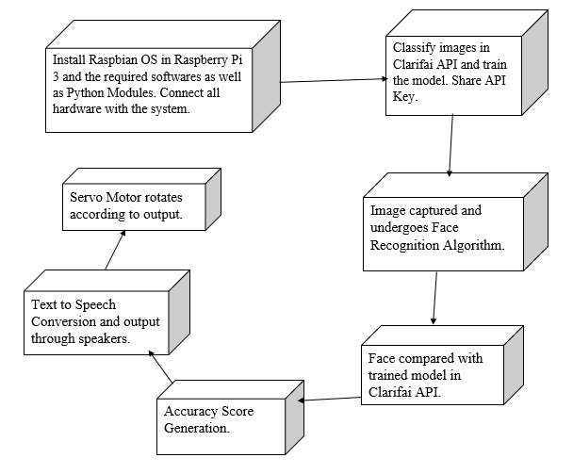
SYSTEM ARCHITECTURE

Slide 9
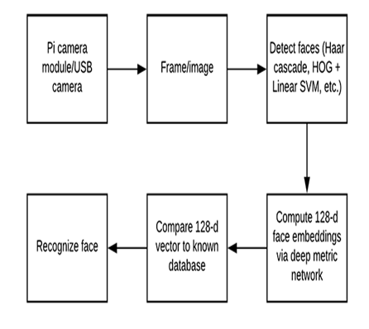
BLOCK DIAGRAM FOR FACE RECOGNITION SYSTEM

Slide 10
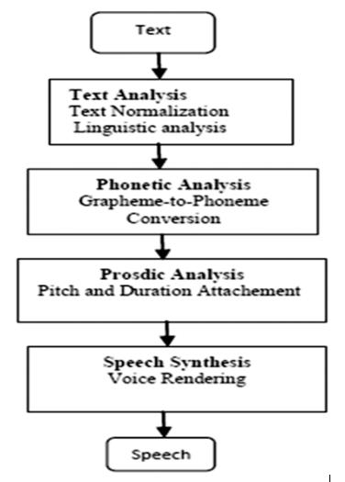
BLOCK DIAGRAM FOR TEXT TO SPEECH CONVERSION

Slide 11
MODULES
cv2
pyttsx
clarifai
RPi
time
datetime

Slide 12
cv2
OpenCV-Python is a library of Python bindings designed to solve computer vision problems.
pyttsx
pyttsx is a cross-platform text to speech Python library which is platform independent.
clarifai
This is the official Python client for interacting with a powerful recognition API. The Clarifai API offers image and video recognition as a service.
RPi
This package provides a class to control the GPIO on a Raspberry Pi.
time
The Python time module provides many ways of representing time in code, such as objects, numbers, and strings.
datetime
We can import a module named datetime to work with dates as date objects.

Slide 13
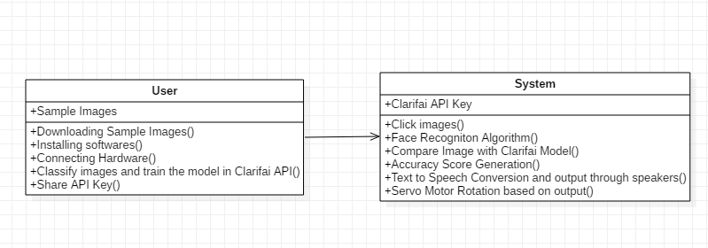
CLASS DIAGRAM

Slide 14
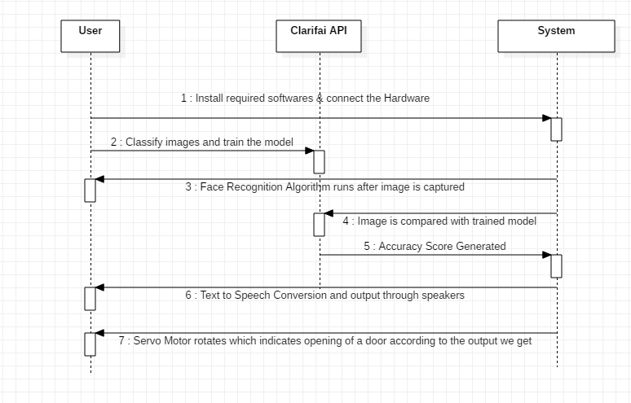
SEQUENCE DIAGRAM

Slide 15
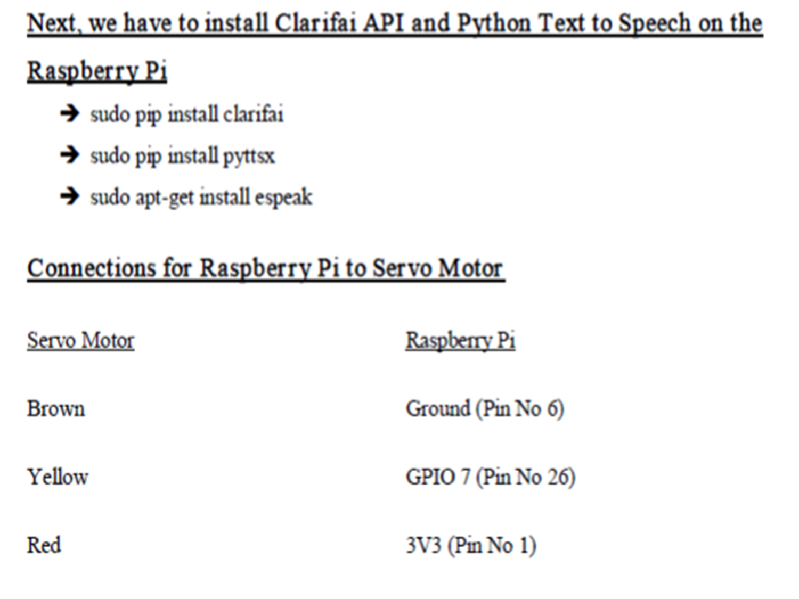

Slide 16
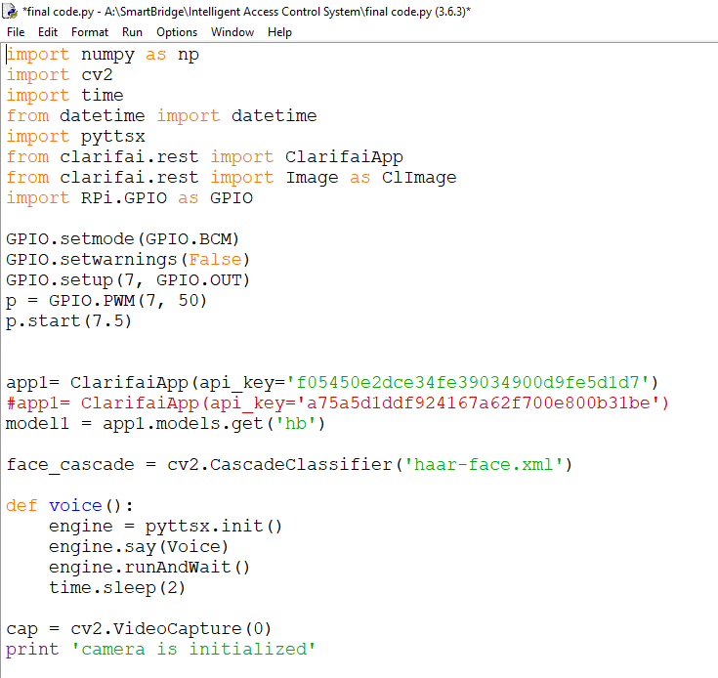

Slide 17
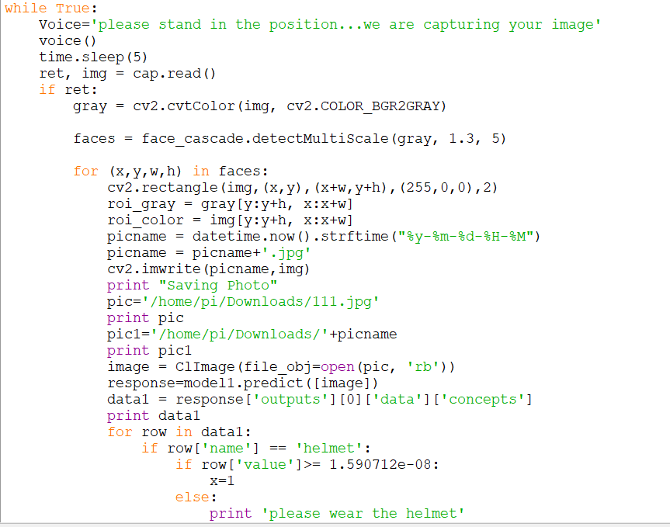

Slide 18
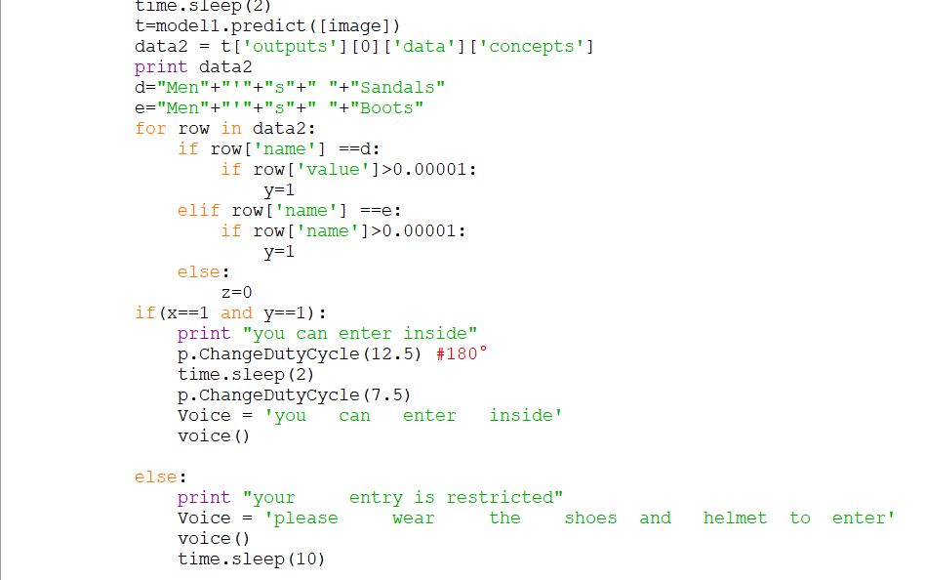

Slide 19
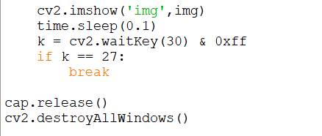

Slide 20
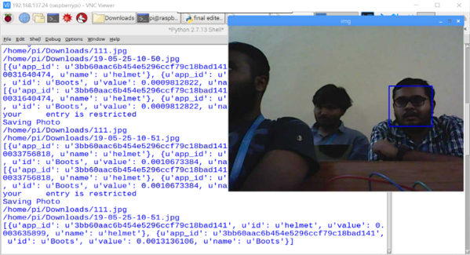

Slide 21
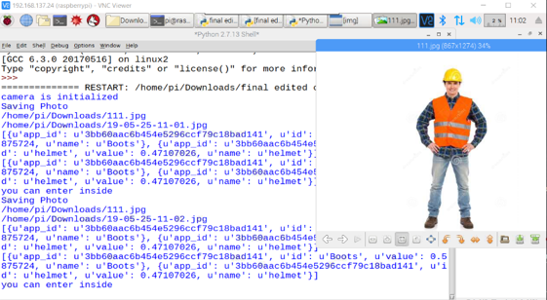

Slide 22
conclusion
The IoT has the potential to dramatically increase the availability of information, and is likely to transform companies and organizations in virtually every industry around the world.
As such, finding ways to leverage the power of the IoT is expected to factor into the strategic objectives of most technology companies, regardless of their industry focus.
IoT will lead to new standards and platforms (APIs, data analysis) in the nearest future.
Practically all platforms are going to be open source as there is very little possibility to monopolize the IoT market.
A new wave of productivity growth is to be expected with overall improvement in quality of life.

Slide 23


